Slide 1


EDGE-BU CSE Digital Skill Traning
Course Title:
Computer Fundamentals & Office Applications
Submitted by
Kazi Maruf
Department of Chemistry
University of Barishal

Slide 2
Course Content:
Microsoft Office
Microsoft word
Microsoft Excel
Microsoft PowerPoint

Slide 3
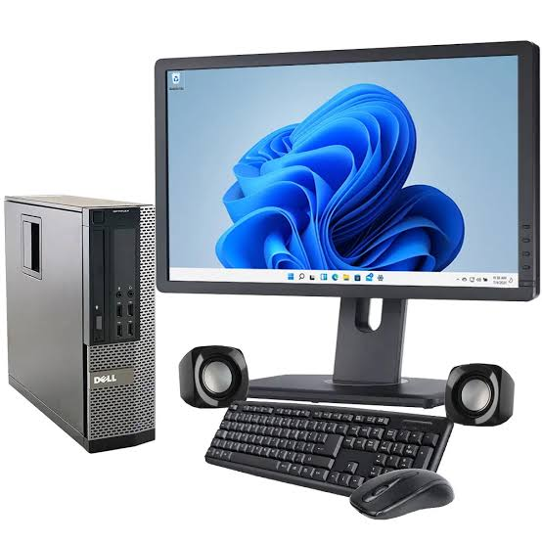
Computer Basics
What is a computer?
A computer is an electronic device that manipulates information, or data. It has the ability to store, retrieve, and process data.

Slide 4
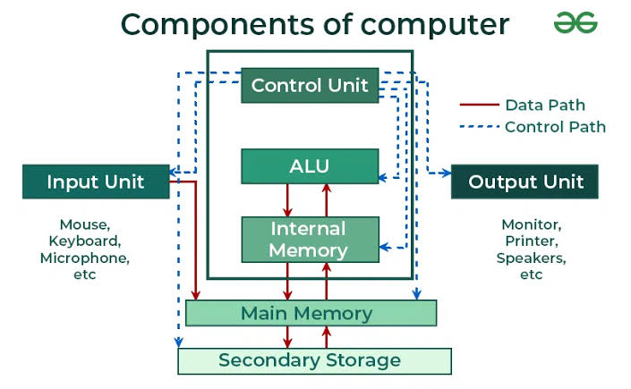
Computer Basics
Computer Basics
Basic Components of Computer

Slide 5
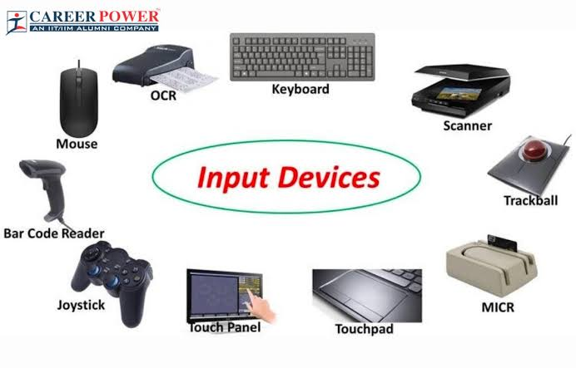
Computer Basics
Computer Basics
Input Devices

Slide 6

Computer Basics
Computer Basics
Output Devices

Slide 7

What is MS Word?
Used to make professional-quality documents, letters, reports, etc., MS Word is a word processor developed by Microsoft. It has advanced features which allow you to format and edit your files and documents in the best possible way.

Slide 8
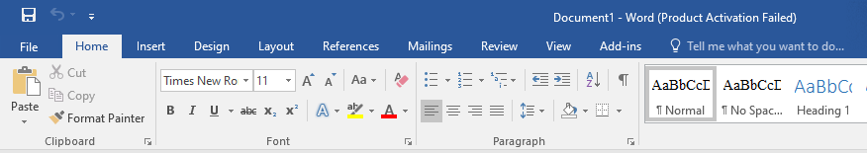
Features of MS Word
Now let us read more about the features and components of an MS Word doc file in detail.
The image given below shows the different elements and categories which are available in MS Word doc:
Home
This has options like font colour, font size, font style, alignment, bullets, line spacing, etc. All the basic elements which one may need to edit their document is available under the Home option.:

Slide 9
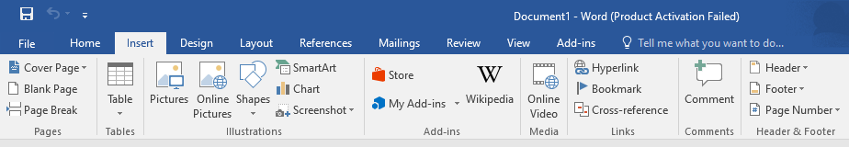
Insert
Tables, shapes, images, charts, graphs, header, footer, page number, etc. can all be entered in the document. They are included in the “Insert” category.

Slide 10
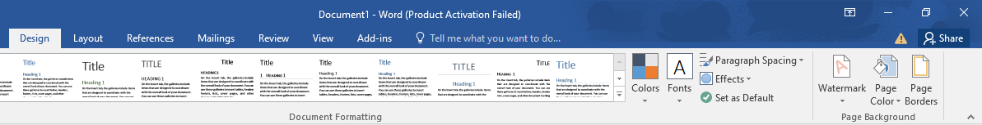
Design
The template or the design in which you want your document to be created can be selected under the Design tab. Choosing an appropriate tab will enhance the appearance of your document.

Slide 11
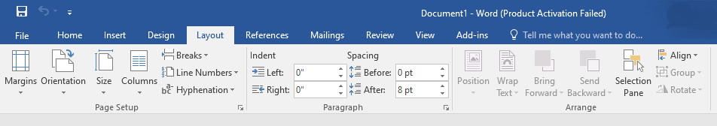
Page Layout
Under the Page Layout tab comes options like margins, orientation, columns, lines, indentation, spacing, etc.

Slide 12
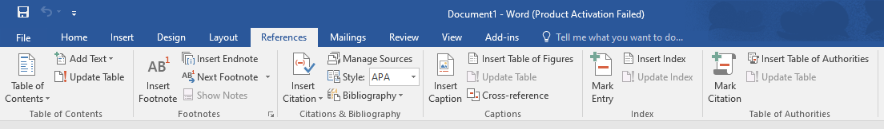
References
This tab is the most useful for those who are creating a thesis or writing books or lengthy documents. Options like citation, footnote, table of contents, caption, bibliography, etc. can be found under this tab.

Slide 13
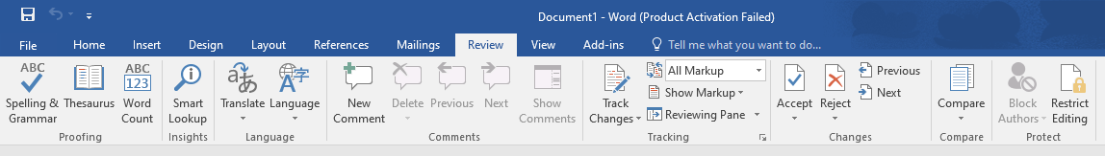
Review
Spell check, grammar, Thesaurus, word count, language, translation, comments, etc. can all be tracked under the review tab. This acts as an advantage for those who get their documents reviewed on MS Word.

Slide 14
Uses of MS Word
In Education: It is considered as one of the simplest tools which can be used by both teachers and students. Creating notes is easier using MS Word as they can be made more interactive by adding shapes and images. It is also convenient to make assignments on MS Word and submitting them online
In Workplace: Submitting letters, bills, creating reports, letterheads, sample documents, can all easily be done using MS Word
Creating & Updating Resume: One of the best tools to create your resumes and is easy to edit and make changes in it as per your experience
For Authors: Since separate options are available for bibliography, table of contents, etc., it is the best tool which can be used by authors for writing books and adjusting it as per the layout and alignment of your choice

Slide 15

What is Microsoft Excel?
Microsoft Excel is spreadsheet software designed and developed by Microsoft for various computing devices running on Windows, Linux, Android, and Mac Operating systems. MS Excel performs business intelligence and data analytics functions by generating visually appealing charts.

Slide 16
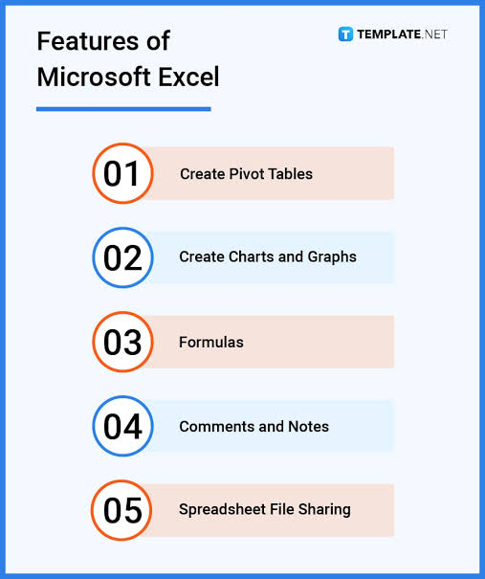
Feathers of Ms Excel

Slide 17
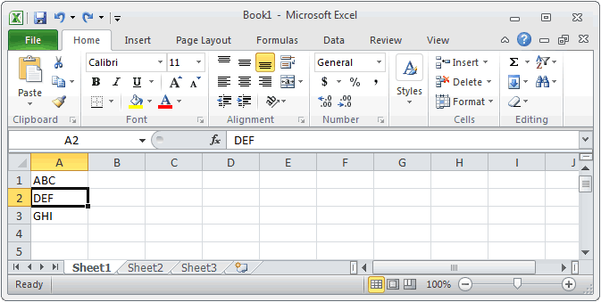
MS Excel Home Page

Slide 18
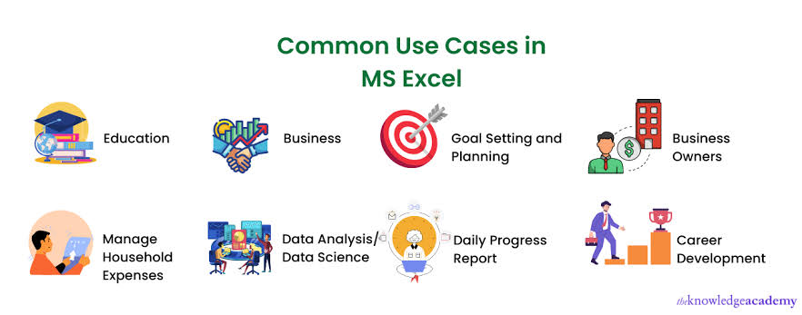

Slide 19

What is MS PowerPoint?
PowerPoint (PPT) is a powerful, easy-to-use presentation graphics software program that allows you to create professional-looking electronic slide shows.
What is a PowerPoint presentation or PPT?
A combination of various slides depicting a graphical and visual interpretation of data, to present information in a more creative and interactive manner is called a PowerPoint presentation or PPT.

Slide 20
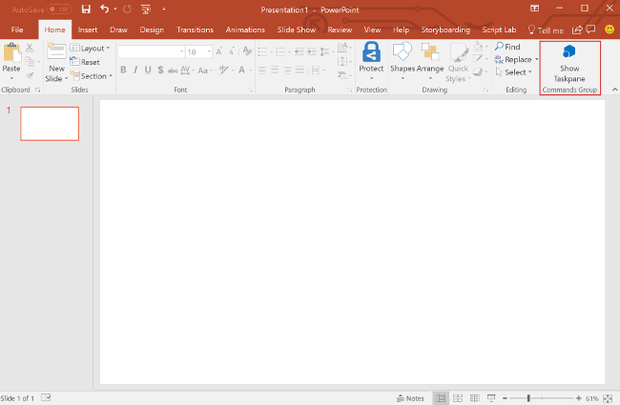
The image given below shows the main page of MS PowerPoint, where a person lands when the program is opened on a computer system:

Slide 21
Microsoft PowerPoint is a powerful presentation software that offers a wide range of features to create visually appealing and interactive presentations. Here are some key features:
Slides: PowerPoint allows users to create individual slides containing text, images, videos, charts, graphs, and other multimedia elements.
Templates: It provides a variety of built-in templates and themes to choose from, making it easy to create professional-looking presentations quickly.
Transitions and Animations: PowerPoint offers a range of transition effects and animations to add visual appeal and make presentations more engaging.
Graphics and Multimedia Integration: Users can easily insert images, audio, video, and other multimedia elements into their presentations to enhance content and convey messages effectively.
Charts and Graphs: PowerPoint includes tools for creating various types of charts and graphs, such as bar charts, pie charts, line graphs, and more, to visualize data and statistics.

Slide 22
Microsoft PowerPoint is a powerful presentation software that offers a wide range of features to create visually appealing and interactive presentations. Here are some key features:
SmartArt: SmartArt graphics allow users to create visually appealing diagrams, hierarchies, and flowcharts to illustrate concepts and processes.
Presenter View: Presenter View allows presenters to view speaker notes, upcoming slides, and a timer on their screen while the audience sees only the current slide.
Collaboration: PowerPoint offers features for collaboration, such as co-authoring, comments, and version history, allowing multiple users to work on the same presentation simultaneously and track changes.
Slide Master: The Slide Master feature allows users to create and customize slide layouts, fonts, colors, and backgrounds consistently throughout the presentation.
Integration with Other Microsoft Office Applications: PowerPoint seamlessly integrates with other Microsoft Office applications like Word, Excel, and Outlook, allowing users to embed objects and content from these applications into their presentations.

Slide 23
Thank You

